Slide 1
Access Specifiers and Nested class
Prepared By: Dimple Bohra

Slide 2

Types of access specifiers

Slide 3
What will be the output??
class Main
{
private String name;
}
class Private
{
public static void main(String args[])
{
Private p=new Private();
p.name="VESIT";
}
}

Slide 4

What will be the output??
class Main
{
private String name;
}
class Private
{
public static void main(String args[])
{
Private p=new Private();
p.name="VESIT";
}
}

Slide 5

Updated Program
class Main
{
private String name;
public String getName()
{
return this.name;
}
public void setName(String name)
{
this.name= name;
}
}
class Data
{
public static void main(String[] main)
{
Main obj = new Main();
obj.setName("VESIT");
System.out.println(obj.getName());
}
}
Notes:
We cannot declare classes and interfaces private in Java. However, the nested classes can be declared private.

Slide 6

Program using Default
class Main
{
static String name;
}
class Private extends Main
{
public static void main(String args[])
{
Main m=new Main();
m.name="VESIT";
System.out.println("Name is:"+name);
}
}
Notes:
We cannot declare classes and interfaces private in Java. However, the nested classes can be declared private.

Slide 7
What will be the output??
class Student
{
protected void display()
{
System.out.println("I am UG student");
}
}
class UG extends Student
{
public static void main(String[] args)
{
UG s1=new UG();
s1.display();
}
}

Slide 8

class Student
{
protected void display()
{
System.out.println("I am UG student");
}
}
class UG extends Student
{
public static void main(String[] args)
{
UG s1=new UG();
s1.display();
}
}

Slide 9
What will be the output??
class Student {
public int subcount;
public void display()
{
System.out.println("I am UG student.");
System.out.println("I have " + subcount + " subjects.");
}
}
class Course
{
public static void main( String[] args )
{
Student s1 = new Student();
s1.subcount = 4;
s1.display();
}
}

Slide 10

What will be the output??
class Student {
public int subcount;
public void display()
{
System.out.println("I am UG student.");
System.out.println("I have " + subcount + " subjects.");
}
}
class Course
{
public static void main( String[] args )
{
Student s1 = new Student();
s1.subcount = 4;
s1.display();
}
}

Slide 11
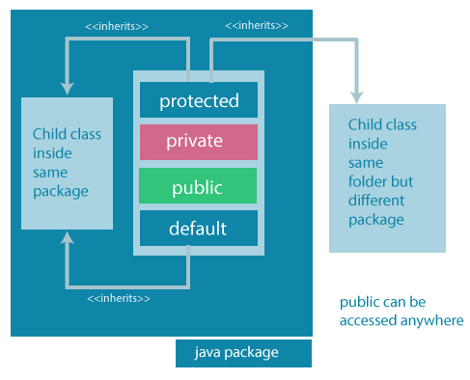
Access Specifiers/Modifiers summarized in one diagram
Notes:
Access modifiers are mainly used for encapsulation. We can help us to control what part of a program can access the members of a class. So that misuse of data can be prevented.

Slide 12
Nested Class

Slide 13
What is Nested class?
In Java, it is possible to define a class within another class, such classes are known as nested classes.
They enable you to logically group classes that are only used in one place, thus this increases the use of encapsulation
It creates more readable and maintainable code.

Slide 14
Syntax
class OuterClass
{ ...
class NestedClass
{
}
}

Slide 15
Why to use Nested classes?
It is a way of logically grouping classes that are only used in one place
It increases encapsulation
It can lead to more readable and maintainable code
Notes:
1. : If a class is useful to only one other class, then it is logical to embed it in that class and keep the two together. Nesting such "helper classes" makes their package more streamlined.
2. : Consider two top-level classes, A and B, where B needs access to members of A that would otherwise be declared private. By hiding class B within class A, A's members can be declared private and B can access them. In addition, B itself can be hidden from the outside world.
3. : Nesting small classes within top-level classes places the code closer to where it is used.

Slide 16
Scope of nested class
The scope of a nested class is bounded by the scope of its enclosing class.
A nested class has access to the members, including private members, of the class in which it is nested. However, the reverse is not true i.e., the enclosing class does not have access to the members of the nested class.
As a member of its enclosing class, a nested class can be declared private, public, protected, or package private(default).

Slide 17
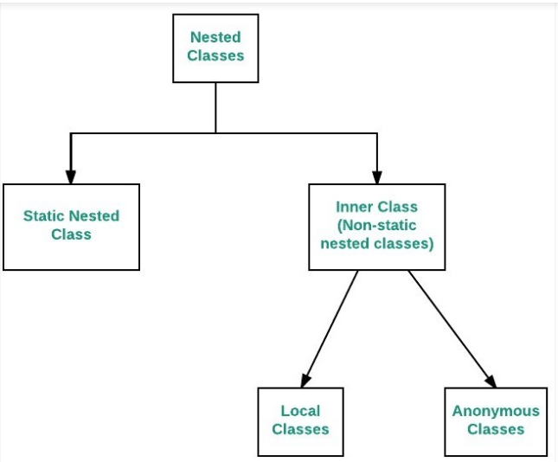
Types of Nested Class
class OuterClass {
...
static class StaticNestedClass {
...
}
class InnerClass {
...
}
}

Slide 18
Static Nested class
Just like class methods and variables, a static nested class is associated with its outer class.
Like static class methods, a static nested class cannot refer directly to instance variables or methods defined in its enclosing class: it can use them only through an object reference.
Notes:
A static nested class interacts with the instance members of its outer class (and other classes) just like any other top-level class. In effect, a static nested class is behaviorally a top-level class that has been nested in another top-level class for packaging convenience.

Slide 19
Static Nested class
Static nested classes are accessed using the enclosing class name:
OuterClass.StaticNestedClass
To create an object for the static nested class, use this syntax:
OuterClass.StaticNestedClass nestedObject =
new OuterClass.StaticNestedClass();

Slide 20

Example of static nested class
class Outermost
{
private static int x=10;
static class Staticnested
{
void run()
{
System.out.println("In nested class\t"+x);
}
}
}
public class OuterTest
{
public static void main(String args[])
{
Outermost.Staticnested obj=new Outermost.Staticnested();
obj.run();
}
}

Slide 21
What happens at compile time?
When a program containing a nested class (static and local inner) is compiled, the compiler generate two .class files, one for the outer class and the other for the inner class that has the reference to the outer class.
For example, the two files are named by compiler as:
Outer.class
Outer$Inner.class

Slide 22
Non-Static Nested class
They are also called inner classes
They can only define non-static members.
Inner classes are associated with an instance of the enclosing class.
As with instance methods and variables, an inner class is associated with an instance of its enclosing class and has direct access to that object's methods and fields.
Notes:
Also, because an inner class is associated with an instance, it cannot define any static members itself.

Slide 23

Example of inner class
class OuterClass
{
int x = 10;
class InnerClass
{
int y = 5;
}
}
public class DriverClass
{
public static void main(String[] args)
{
OuterClass myOuter = new OuterClass();
OuterClass.InnerClass myInner = myOuter.new InnerClass();
System.out.println(myInner.y + myOuter.x);
}
}

Slide 24

Example of inner class
class Outer
{
int num = 10;
class Inner
{
public void Access()
{
System.out.println("Outer member : " + num);
}
}
}
public class InnerOuterDemo
{
public static void main(String[] args)
{
Outer.Inner i = new Outer().new Inner();
i.Access();
}
}

Slide 25
Types of inner class
Local inner classes
Anonymous inner classes

Slide 26
Local inner classes
Local Inner Classes are the inner classes that are defined inside a block. Generally, this block is a method body.
Sometimes this block can be a for loop, or an if clause.
Local Inner classes are not a member of any enclosing classes. They belong to the block they are defined within, due to which local inner classes cannot have any access modifiers associated with them.
Local inner class must be instantiated in the block they are defined in.

Slide 27

Example of Local inner class
public class Outer
{
private void getValue()
{
int sum = 20;
class Inner
{
private void print()
{
System.out.println("Value of sum is:"+sum);
}
}
Inner in = new Inner();
in.print();
}
public static void main(String[] args)
{
Outer o = new Outer();
o.getValue();
}
}

Slide 28
Anonymous inner class
It is an inner class without a name and for which only a single object is created.
An anonymous inner class can be useful when making an instance of an object with certain “extras” such as overloading methods of a class or interface, without having to actually subclass a class.
Anonymous inner classes are useful in writing implementation classes for listener interfaces in graphics programming.

Slide 29
Anonymous inner class
Syntax:
Test t = new Test()
{
// data members and methods
public void test_method()
{
........
........
}
};
Anonymous inner classes are mainly created in two ways:
Class
Interface
Notes:
The syntax of an anonymous class expression is like the invocation of a constructor, except that there is a class definition contained in a block of code.

Slide 30

Example of Anonymous inner class
interface Age
{
int x = 21;
void getAge();
}
class Anonymous
{
public static void main(String[] args)
{
MyClass obj=new MyClass();
obj.getAge();
}
}
class MyClass implements Age
{
public void getAge()
{
System.out.print("Age is "+x);
}
}

Slide 31
Thank You!!

